Slide 1
Cedez Marie Gulane
Goldy Mariz Lunesa
Carl Jun Piao
Julius Morgan Umacob
Kim Morsha Zaldua

Slide 2
It is a platform where students can arrange and schedule tutorials with one another.
It is an online place where UP Cebu students can find where and who they can ask help from and a place where they can help out others as well.
TutoreCo is a website and a mobile application available for UP Cebu students.

Slide 3
Functions & Features
FIND TUTORS & TUTEES
There are two panels to find posts made by tutors and tutees
POSTS BY TUTEES
POSTS BY TUTORS
Posts made by tutors and tutees are separated so that it will be easier and more efficient to locate and perhaps arrange tutorial schedules depending on the student’s interest.

Slide 4
Functions & Features
WRITE POSTS AS A TUTEE OR AS A TUTOR
A student can write a post in the website or mobile app to ask for help or advertise a tutorial session he/she wants to hold.
Depending on whether the students is writing a post as a tutee or a tutor, his/her post will be displayed in the respective panel.
The student’s post will be seen by everyone who will scroll down and check out the panels where the posts are located.

Slide 5
Functions & Features
TUTOR LIST/ TUTOR DIRECTORY
For tutees convenience, there is a panel that holds the Tutor Directory or the list of all tutors of UP Cebu.
It lists all the tutors and their details, most importantly the subjects or topics they can help other students with.
Tutees can click on their profile and message tutors for tutorial session arrangements.

Slide 6
Functions & Features
MESSAGE A TUTOR/TUTEE TO SET A SCHEDULE
Before a student can set a tutorial session with another student, arrangements should be done through private messaging.
A messaging platform for both tutee and tutor is available.

Slide 7
Functions & Features
SET A TUTORIAL SESSION
After the arrangements done through private messaging, the tutor or the tutee can then set the tutorial session.
There is a form they can fill out with the details of their tutorial session (time, date, location, etc)
Their tutorial session will be reflected in the tutor and tutee’s general schedule in their profiles.

Slide 8
Functions & Features
RATE TUTORS
One day after the scheduled time of a tutorial session, the tutee will receive a notification once he/she logs in to TutoreCo that will prompt him/her to rate his/her tutor.
There will be a form that the tutee can fill out regarding how he/she rates the tutor. The rating will be in a form of how many stars out of 5 will the tutee give the tutor.
The rating will be reflected and updated into the tutor’s rating.

Slide 9
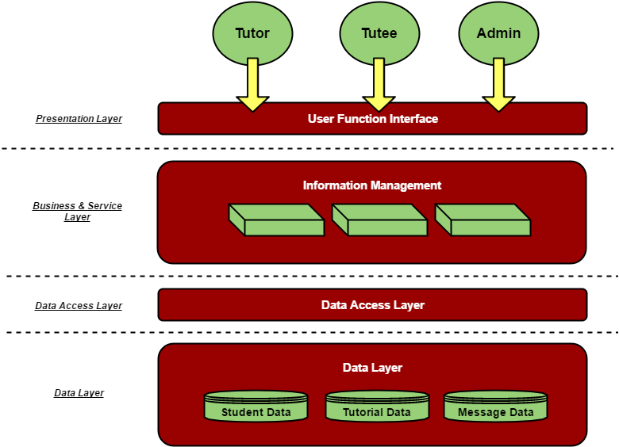
SOFTWARE ARCHITECTURE

Slide 10
USERS
TUTOR
Tutor can be any student in UP Cebu that holds tutorial sessions and teaches or helps out other students on subjects or topics that he/she is knowledgeable.
TUTEE
Tutee can be any student in UP Cebu that holds asks for help on subject or topics he/she needs help with.

Slide 11
USERS
ADMIN
The admin overviews the activities in TutoreCo.
The admin has a special UI designed just for the admin where panels like:
POSTS BY STUDENTS
SCHEDULES OF STUDENTS
MESSAGES OF STUDENTS
LIST OF STUDENTS

Slide 12
USERS
ADMIN
The admin has the authority to delete posts the admin deem inappropriate.
The admin can see messages to and details of tutorials set by students to track them and ensure security as well.

